Slide 1



ZK-firmation
ZK for daily use

Slide 2


Why ZK ?

Slide 3
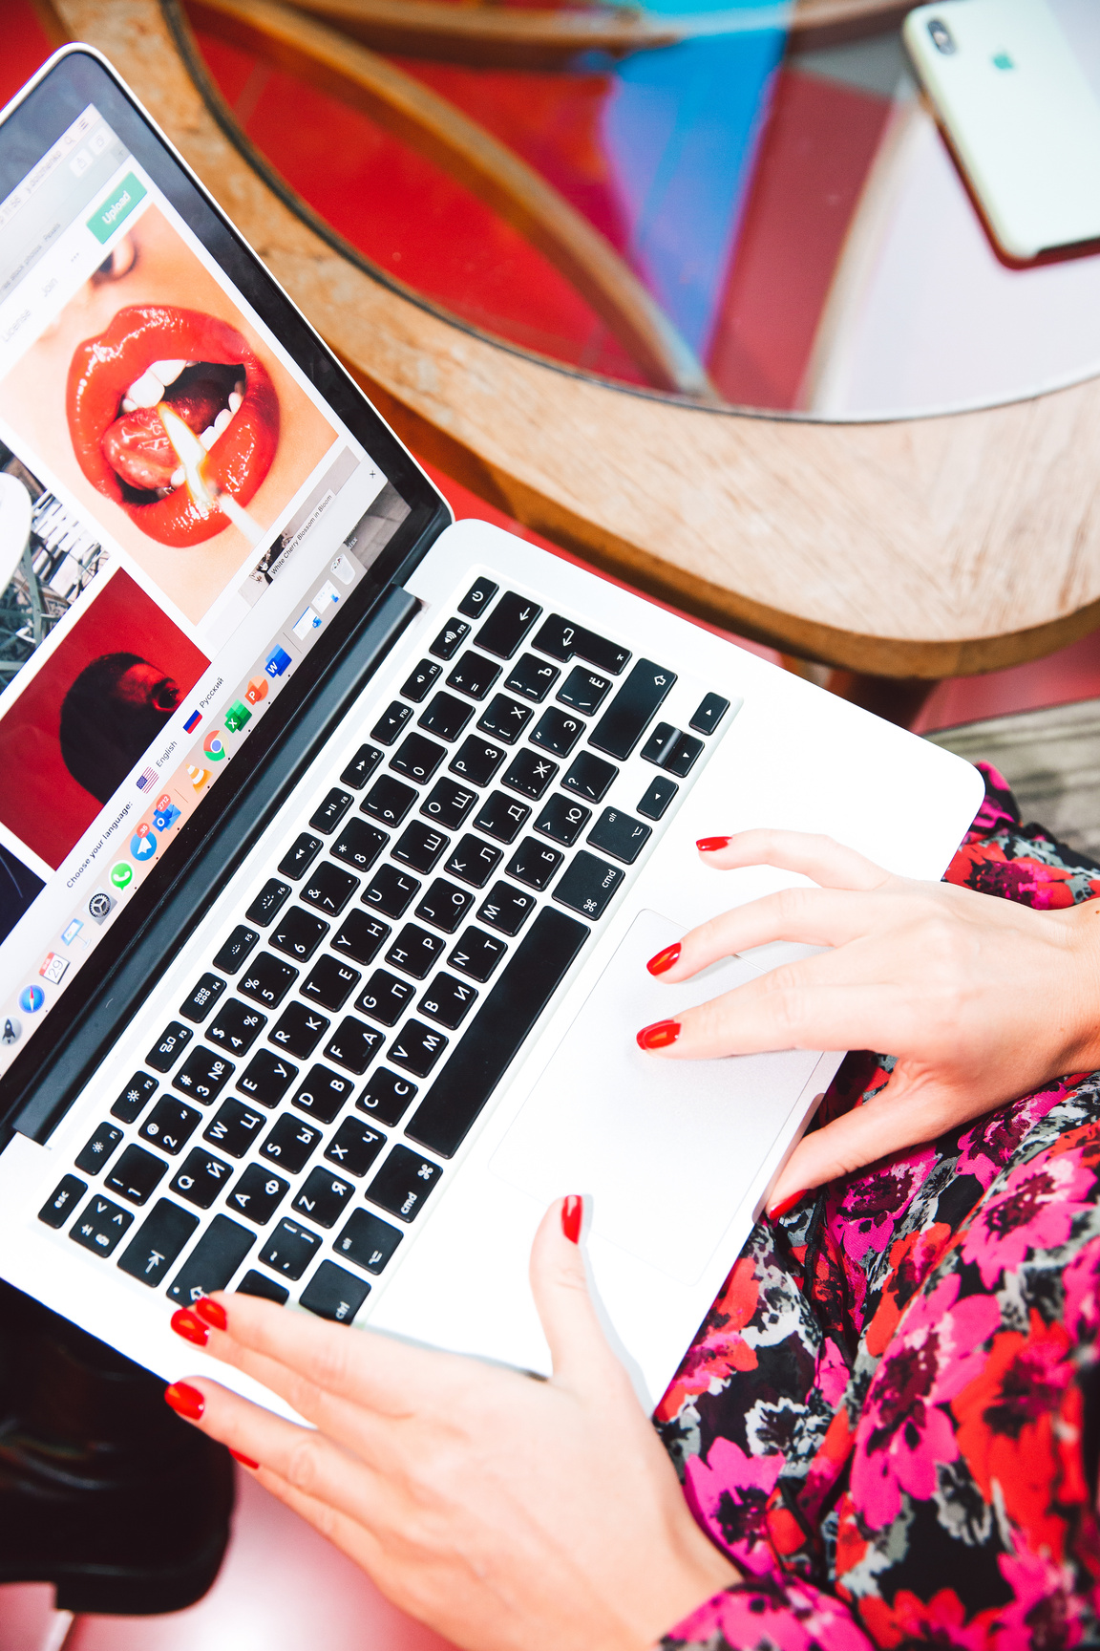
OCR + ZK + AI as a Judge = FUTURE

Slide 4

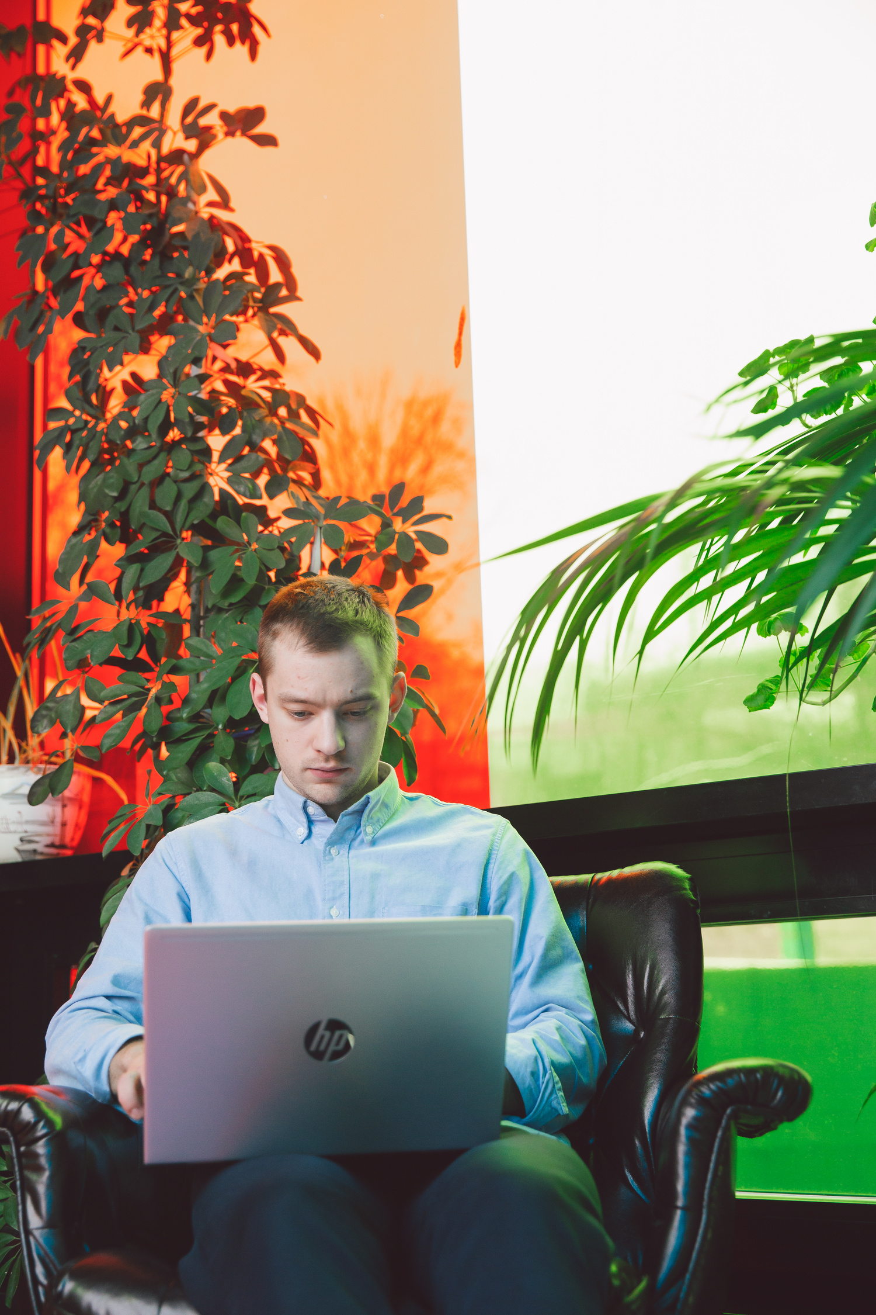


Thats sh*t is cool !
Cutting edge technology for users

